Slide 1
Module- 1

Slide 2
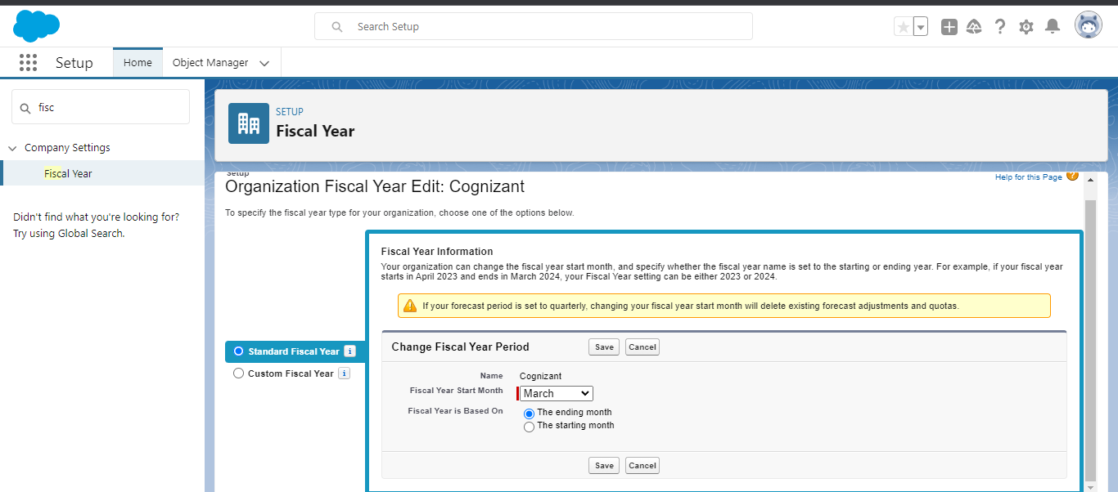
1.a)

Slide 3
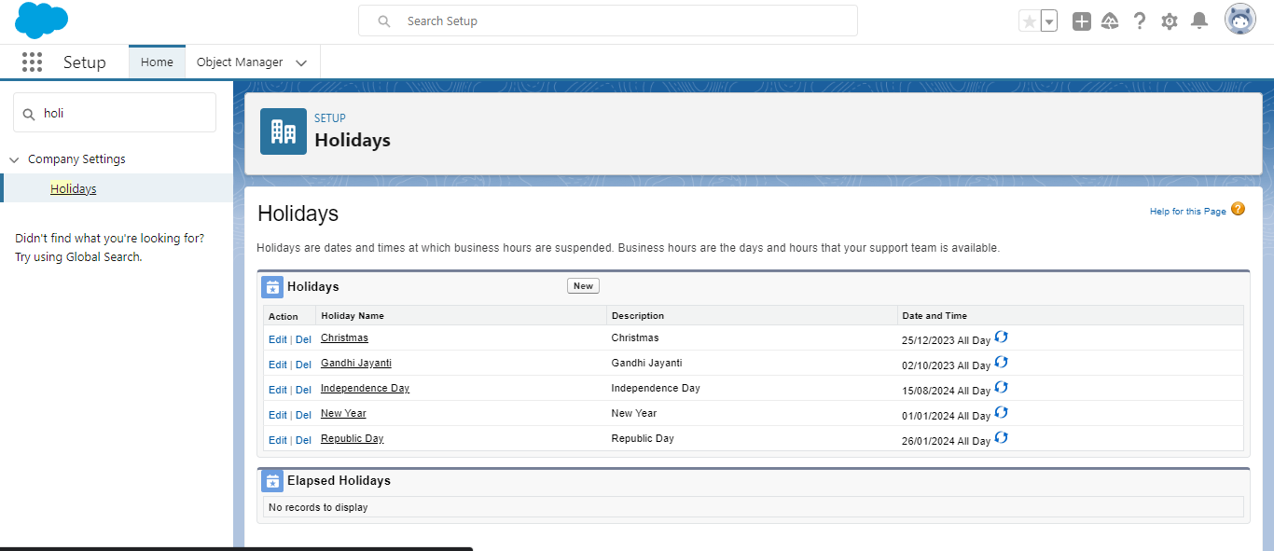
1.b)

Slide 4
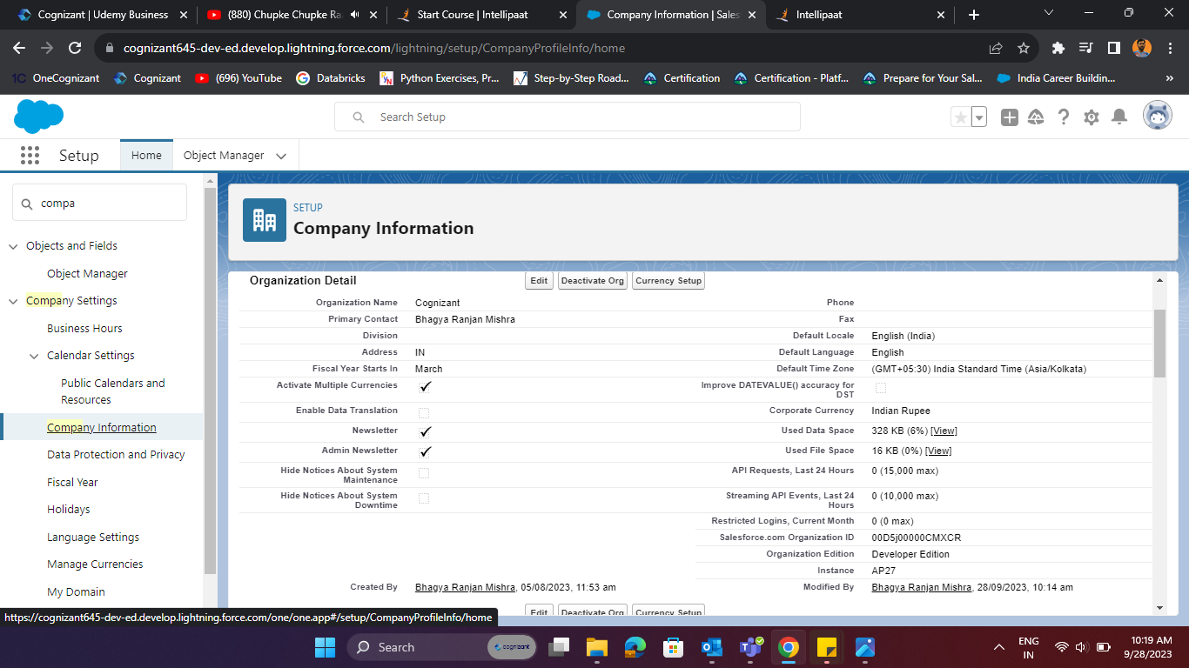
1.c)

Slide 5
1.d)

Slide 6
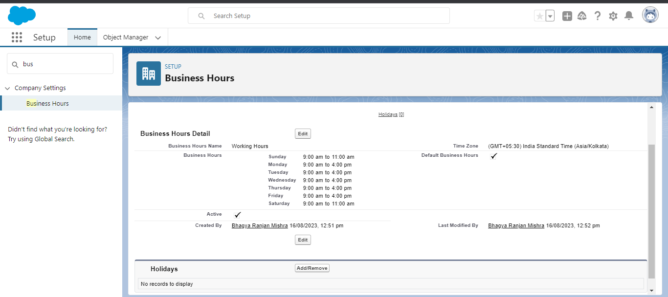
1.e)

Slide 7
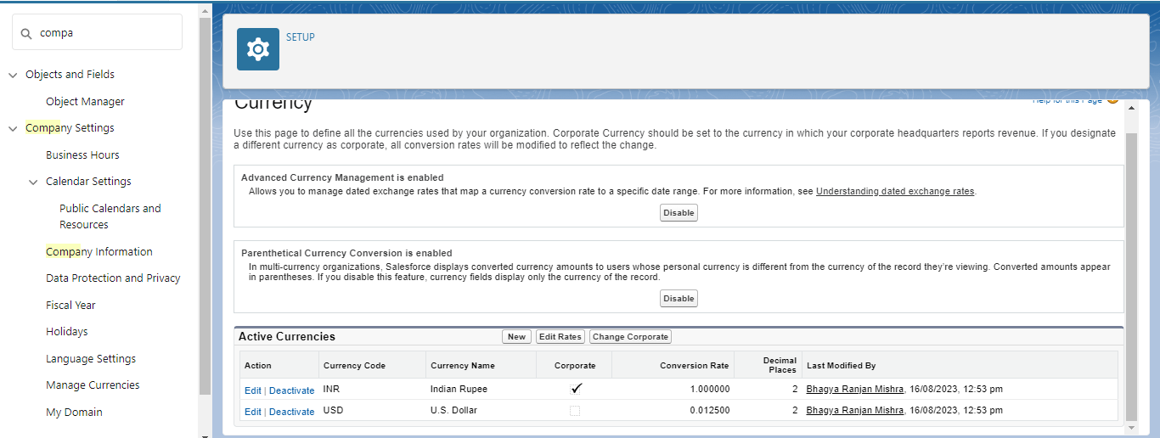
2.a)

Slide 8
2.b) You are the CEO of the company and your opportunities in USD are getting converted but USD had been unstable past year?How can we handle this situation of fluctuating exchange rate?
Ans : In this case we will use Dated Exchange Rates as shown in below picture.

Slide 9
